Slide 1
Large language model
Introductions and applications

Slide 2
Contents
Background
LLM’s history
Real-world application
Terminologies
Basic LLM knowledge
Hands-on activity: run LLM online and locally
Local deployment of LLM
Important skills for study and jobs

Slide 3
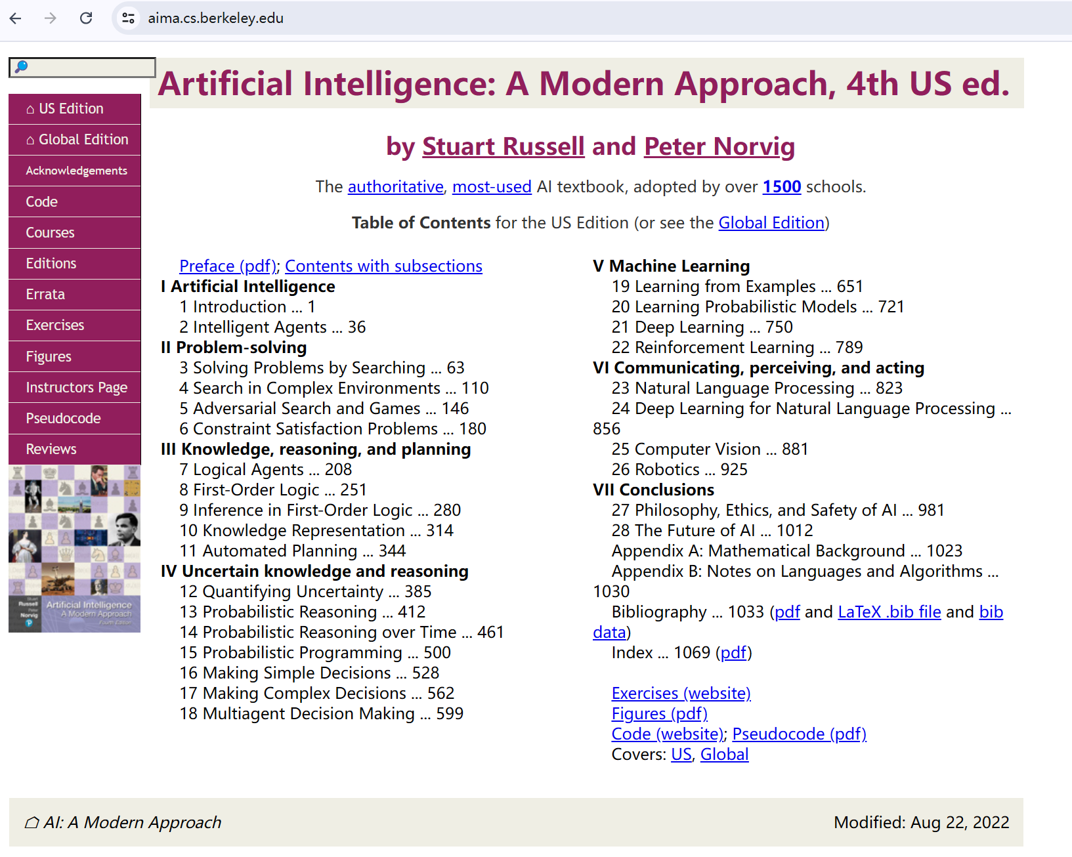
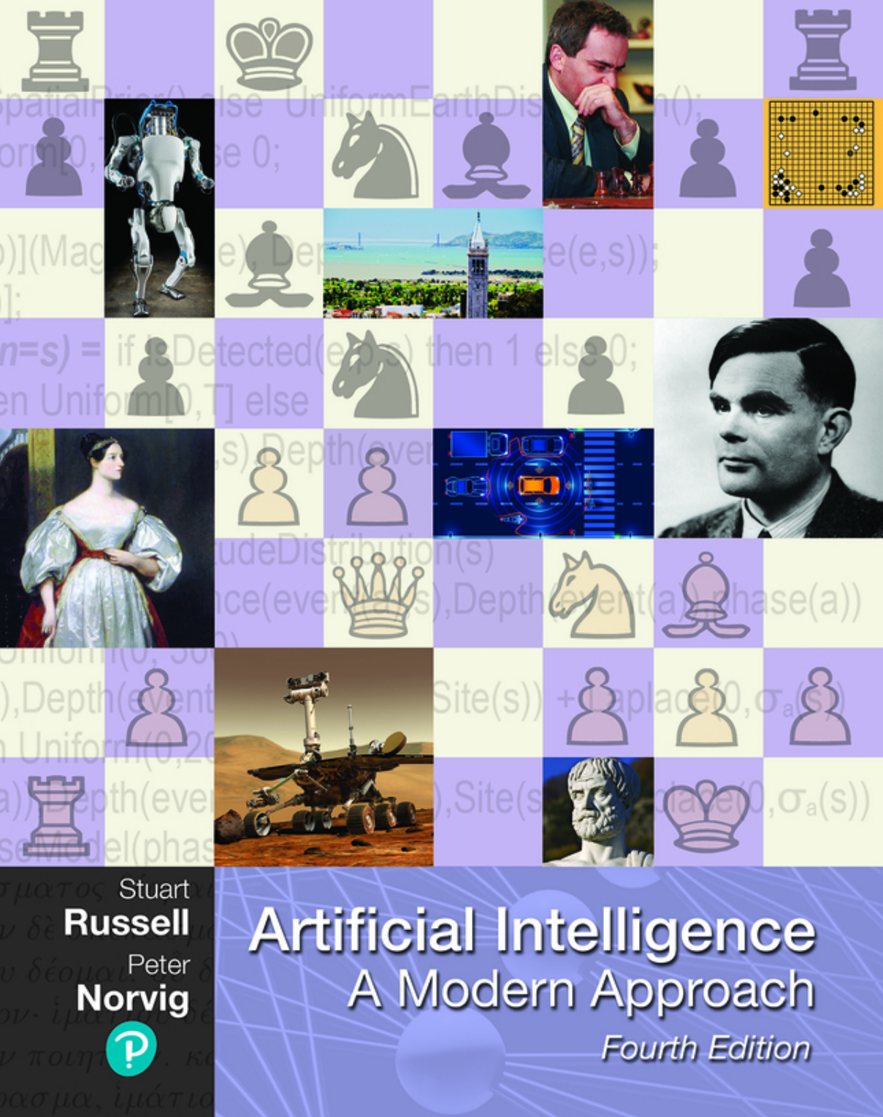
Background: a good textbook
Recommended textbook: Artificial Intelligence: A Modern Approach
Machine learning, modern LLM…
A focus on model mathematical mechanism

Slide 4

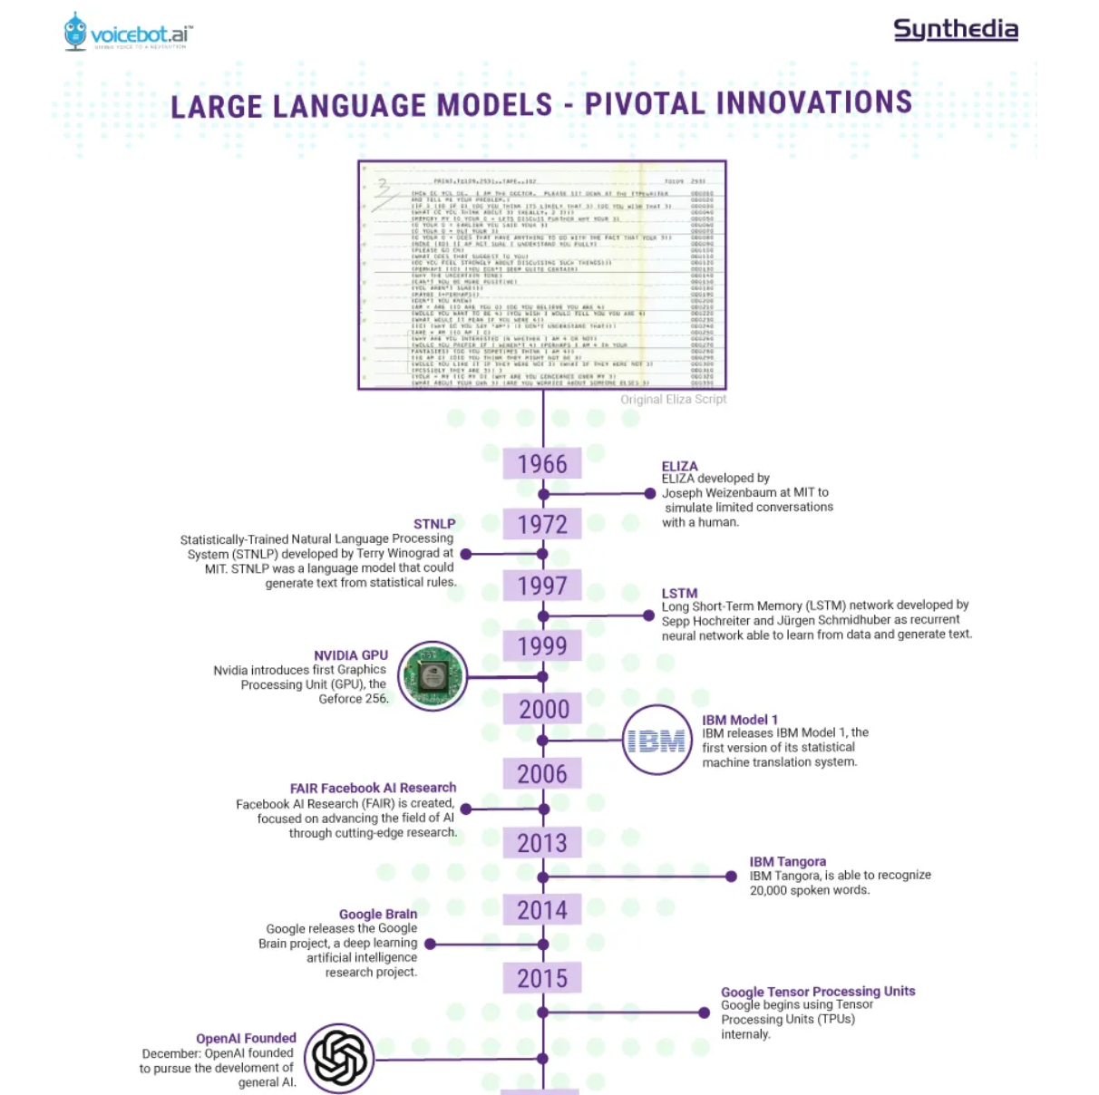
Background: until the ChatGPT moment
https://synthedia.substack.com/p/a-timeline-of-large-language-model
Pivotal innovations, both software and hardware
1999 Nvidia first GPU GeForce 256TM
2007 CUDA
2010 FinFET transistor commercialization
2015 OpenAI founded
2017 Transformer model and Tensor flow framework
2018 GPT-1
2020 GPT-3
2022 InstructGPT, Huggingface, ChatGPT (GPT-3.5 turbo)
2023 GPT-4, Llama, Bard, Qwen, Ernie, Claude……
2024 o1 reasoning model
2025 DeepSeek R1

Slide 5
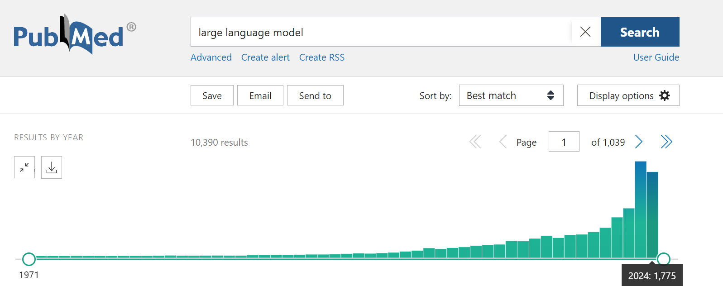
Background: LLM applications
Significant growth in PubMed journal articles
Protein engineering https://www.ncbi.nlm.nih.gov/pmc/articles/PMC10400306/
DNA language model https://www.biorxiv.org/content/biorxiv/early/2023/11/01/2023.06.12.544594.full.pdf
Scientific knowledge synthesis https://arxiv.org/abs/2310.07984

Slide 6
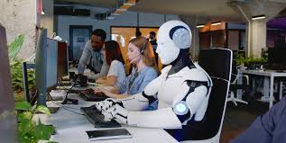
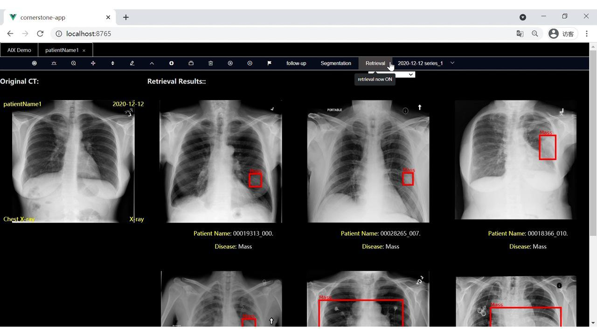
Background: LLM applications
AI customer service
AI-assisted coding
Multi-modal LLM assisted medical diagnosis
…

Slide 7
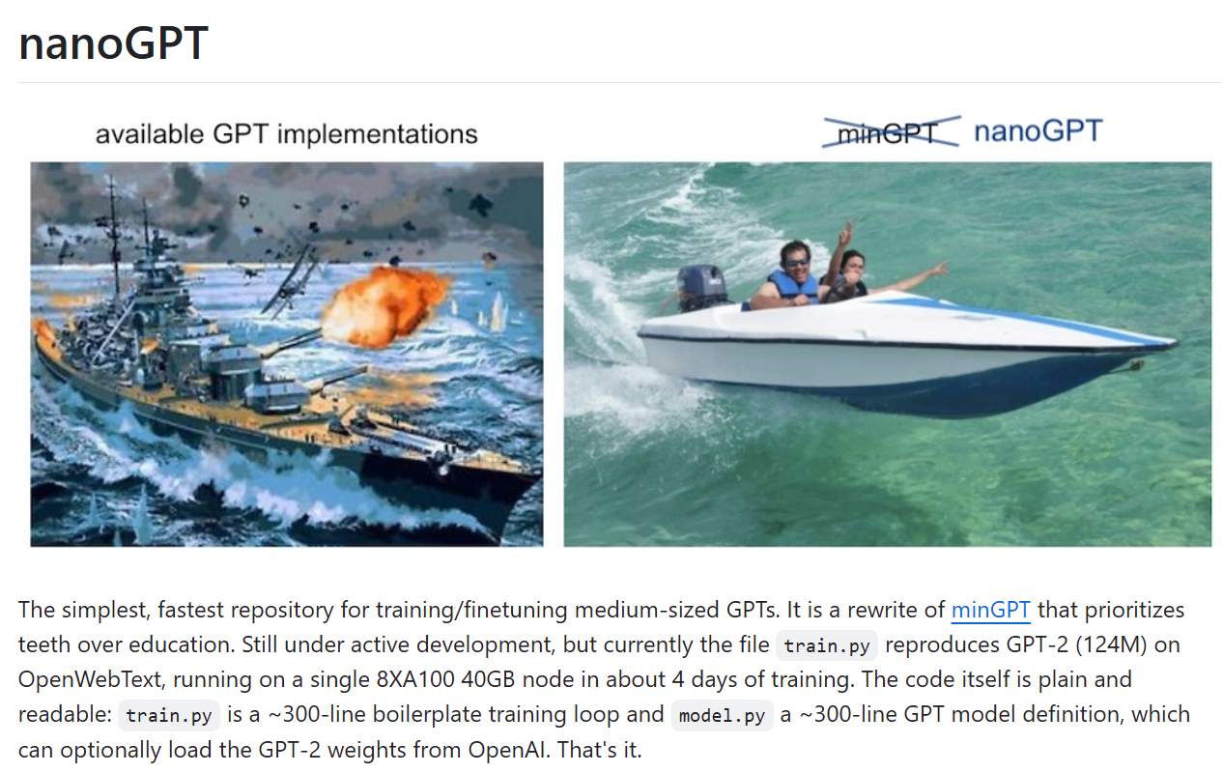
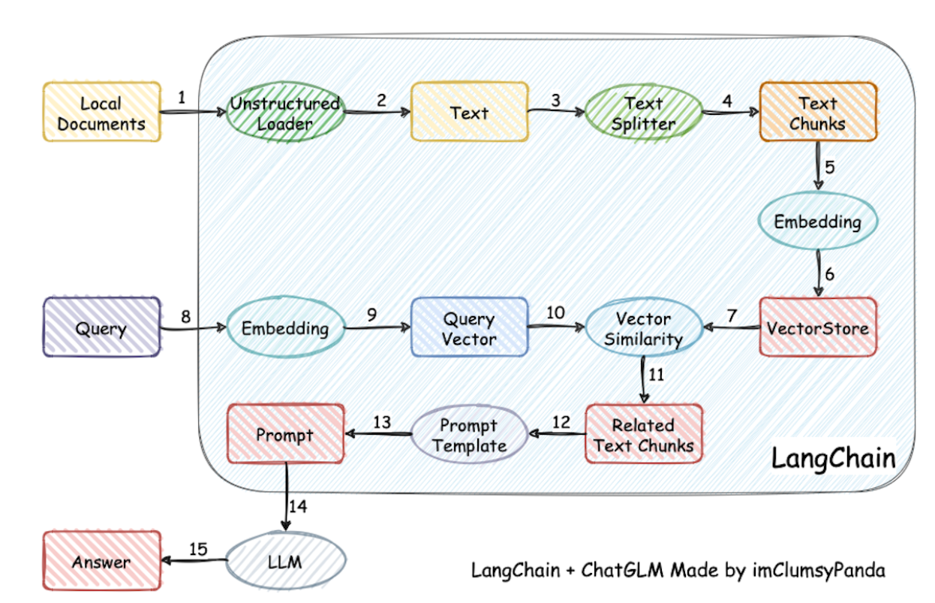
Background: Trending LLM projects as case studies
nanoGPT https://github.com/karpathy/nanoGPT Reproduce a medium size LLM like GPT-2
MiniMind Train a small LLM under $1 cost and 2 hours https://github.com/jingyaogong/minimind/blob/master/README_en.md
Langchain https://github.com/chatchat-space/Langchain-Chatchat/blob/master/README_en.md Database Q and A

Slide 8
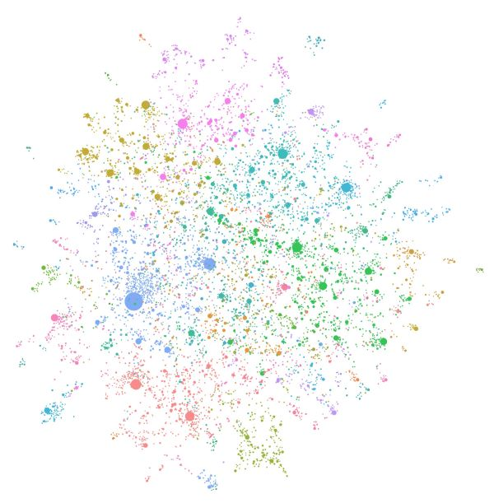
Background: Trending LLM projects as case studies
GraphRAG https://microsoft.github.io/graphrag/ https://github.com/microsoft/graphrag RAG: retrieval augmented generation
An LLM-generated knowledge graph built using GPT-4 Turbo.

Slide 9


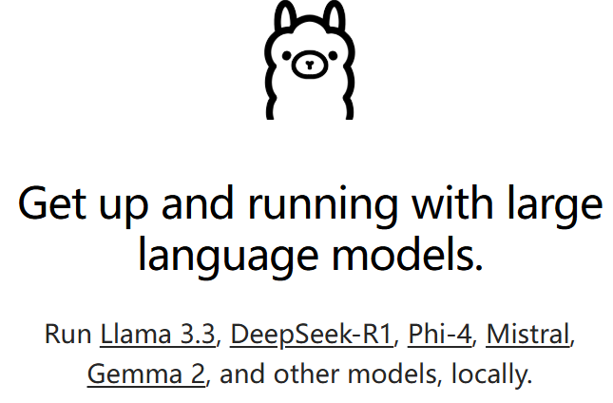
Background: how to use LLM
ChatGPT: 4o, o1, o3-mini
We will have class activities using ChatGPT
Send me your openai account to add in group account
Hugging Face: download pretrained LLM
Python packages: transformers, torch, auto-gptq, llama.cpp…
LM Studio: easy local LLM deployment
We will have class activities using LM Studio.
Ollama: local LLM server API
We will have class activities using Ollama.

Slide 10
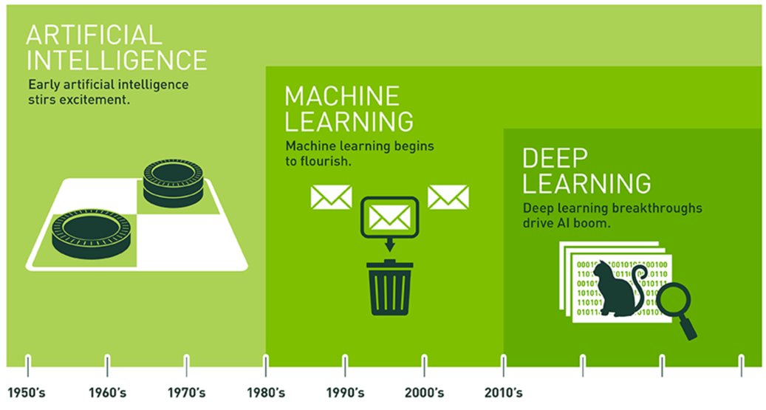
Terminologies: AI, ML, DL, LLM
AI, Machine learning, Deep learning
1956 Dartmouth workshop John McCarthy, Marvin Minsky, Claude Shannon, Allen Newell, and Herbert Simon invented the word Artificial Intelligence.
Machine learning is an approach of artificial intelligence.
Deep learning is a method developed from machine learning.
Large language model (LLM)
LLM is a probability distribution over a token (word) sequence. i.e. What is the probability of certain word sequence?
Given the previous tokens, the model selects the next most probable word: The state capitol of Missouri is ____ P(Jefferson City | The state capitol of Missouri is ) = 0.5 P(Paris | The state capitol of Missouri is) = 0.001
Counter-intuitive question:
Why do large language models require the same computing power to reason about quantum mechanics problems and middle school mathematics problems?

Slide 11
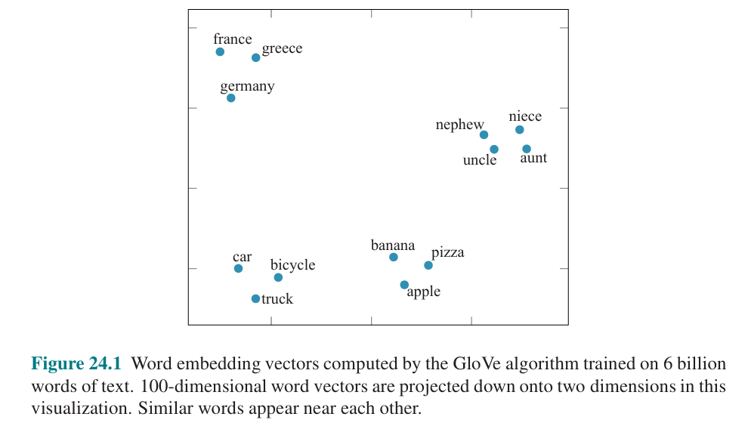
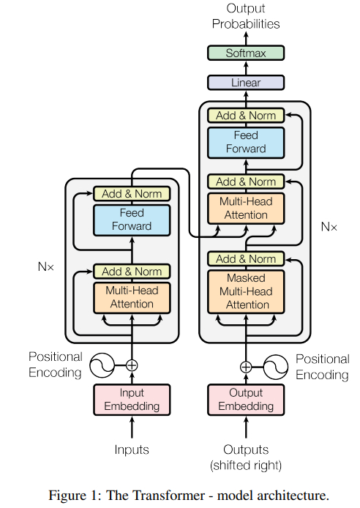
Terminologies: embedding, transformer
Word2Vec embedding
An unsupervised learning of text. Word2Vec captures semantic meanings and represent in vector dimensions.
Lots of derivatives: Gene2Vec, Protein2Vec …
Transformer
Original article https://arxiv.org/abs/1706.03762
Self-attention mechanism: the model calculates scores that how much each token should influence others. However, it is not possible for LLM to attend to all words. The attention of LLM is sparse (just like human).
This model structure is good at generalize language patterns with much lower computational power.

Slide 12
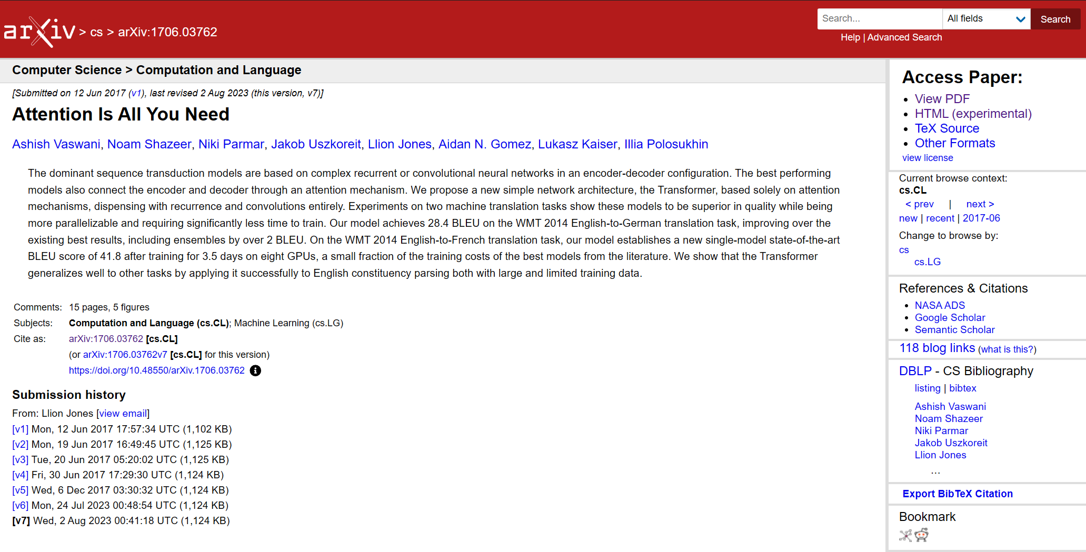
Transformer model structure
https://arxiv.org/abs/1706.03762

Slide 13
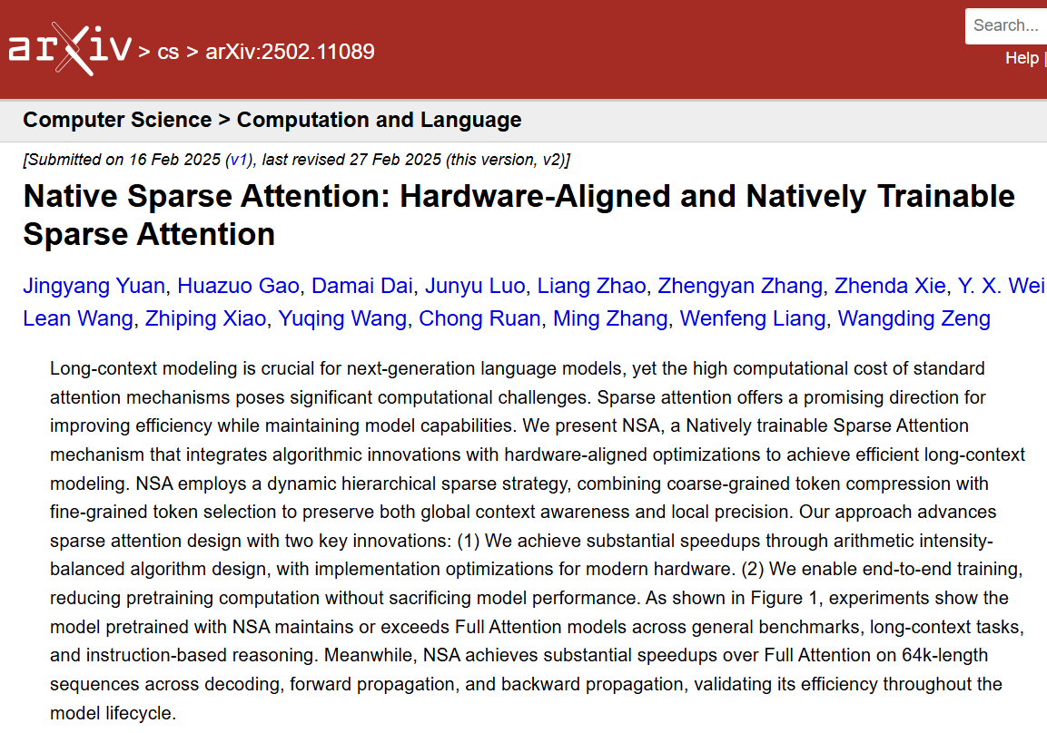
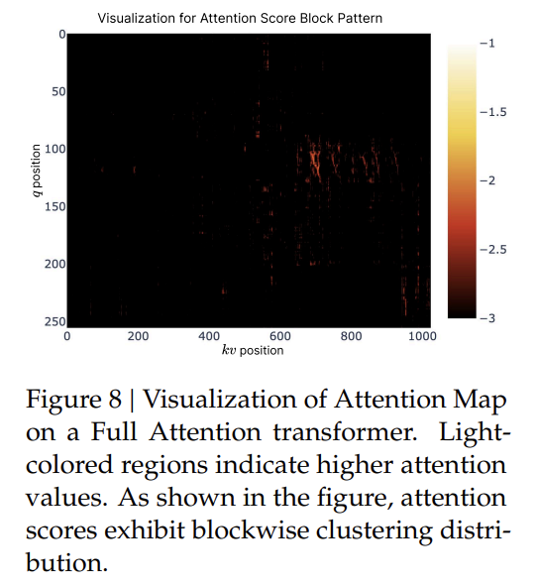
Sparse attention of LLM
https://arxiv.org/abs/2502.11089

Slide 14
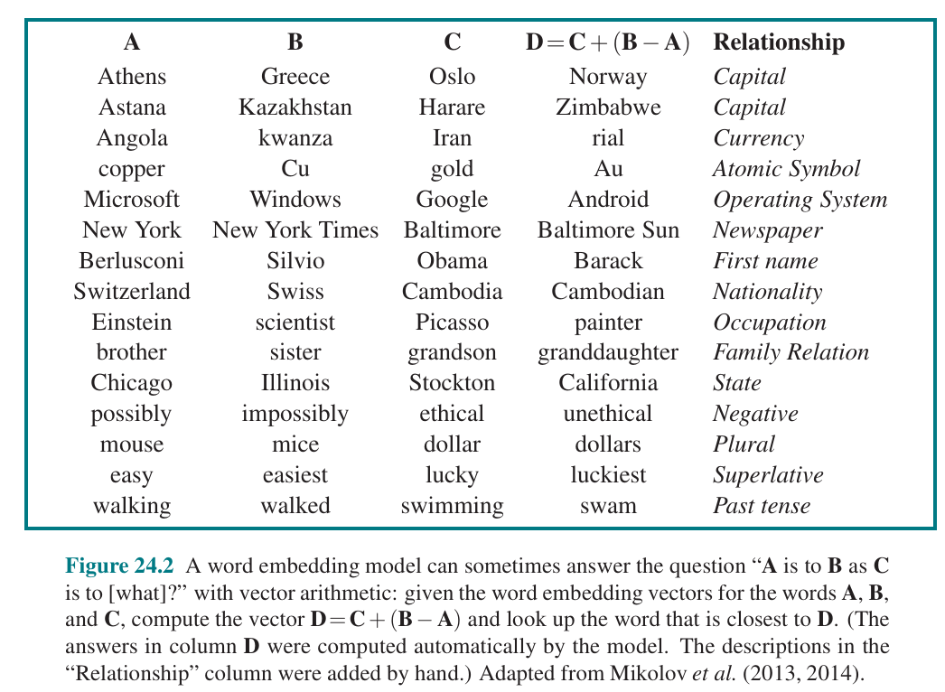
Word2Vec word embedding
Word embedding is a deep learning method for natural language processing (NLP).
Definition: a vector represents a word.
Properties of Word Embeddings
Words with similar meanings have similar vectors.
Semantic relationships can be calculated through vector operations. Assume D is unknown. A, B, and C are known. They have the relationship: B − A = D − C Thus D can be calculated by: D = C +(B − A) For example, A is Athens and B is Greece. B – A is the country/capital relationship. If C is Washington DC, D should be USA.
Embeddings are not interpretable. Individual dimensions do not have clear meanings

Slide 15
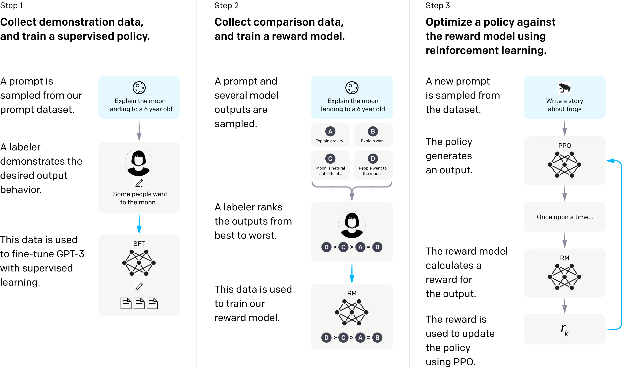
Terminologies: instruction tuning
Instruction tuning (alignment): LLM should follow user instructions.
https://openai.com/index/instruction-following/

Slide 16
Terminologies: Inference, context length, temperature, chain-of-thought, reasoning effort
Inference: The process of running LLM using a prompt.
Quantization: A technique to reduce the precision of numerical values in a LLM to decrease size and increase inference speed.
For example, converting 16-bit floating point precision (fp16) to 4-bit integer (Int4) quantization reduces model size by ~4 times.
This enables LLM deployment on laptops and PCs, but it slightly decreases accuracy for efficiency.
Context length: The maximum number of tokens an LLM can process. Longer context length usually brings better coherence and longer conversations.
Temperature: It controls randomness in the model’s output (0 = deterministic, 1 = creative).
Chain-of-thought: A prompting technique where the model explains its reasoning step by step, similar to human problem-solving.
Conventional GPT LLM: GPT-4o, Qwen2.5-instruct, DeepSeek V3, etc.
Chain-of-thought reasoning LLM: OpenAI o1, o3-mini, DeepSeek R1, etc.
Reasoning effort: The length of Chain-of-thought in a single run.

Slide 17
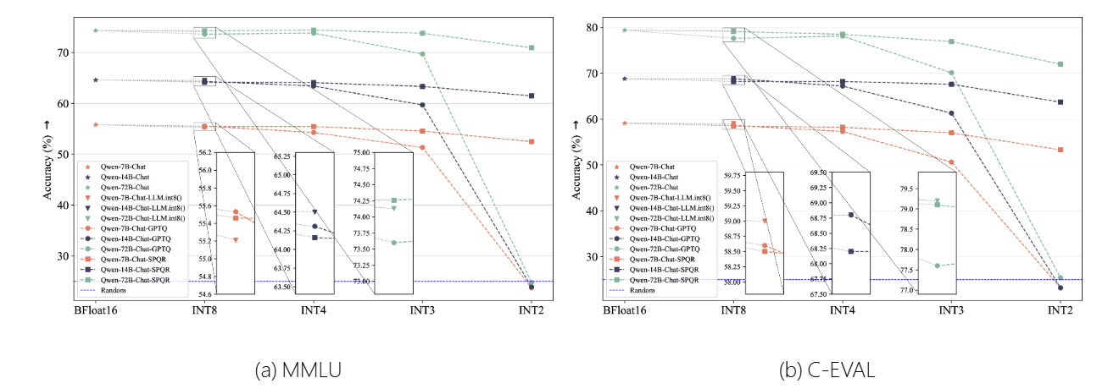
Quantization’s effect on LLM accuracy
https://arxiv.org/html/2402.16775v1

Slide 18
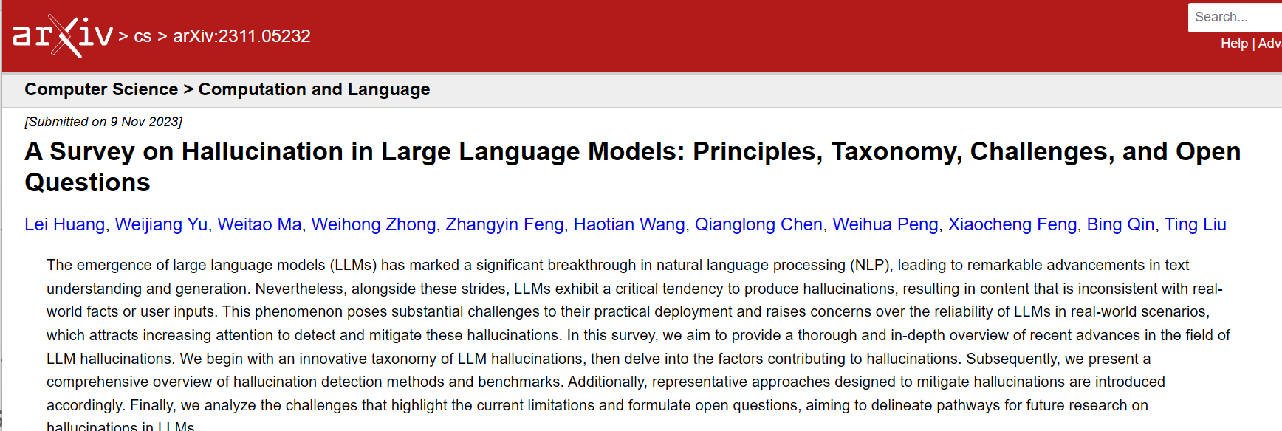
Terminologies: hallucination
Machine hallucinations
LLM does not 100% factual.
Hallucination problem was severe in early times, but much better now.
Users are advised to check important facts.
https://arxiv.org/abs/2311.05232

Slide 19
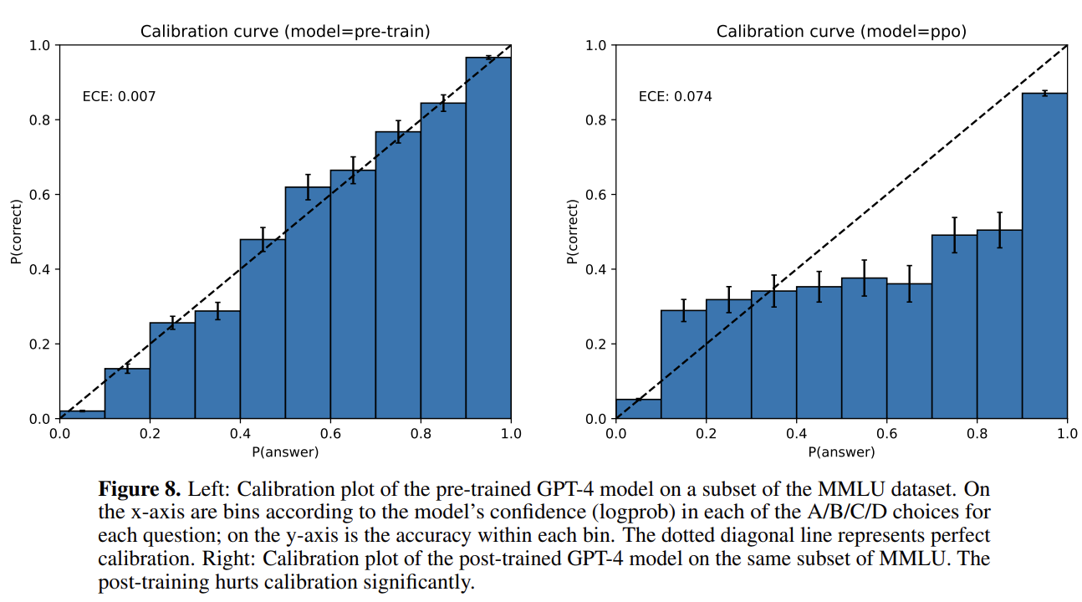
Terminologies: hallucination
Hallucination: LLM responses that are not true.
Instruction tuning sometimes causes hallucinations.
https://arxiv.org/pdf/2303.08774

Slide 20
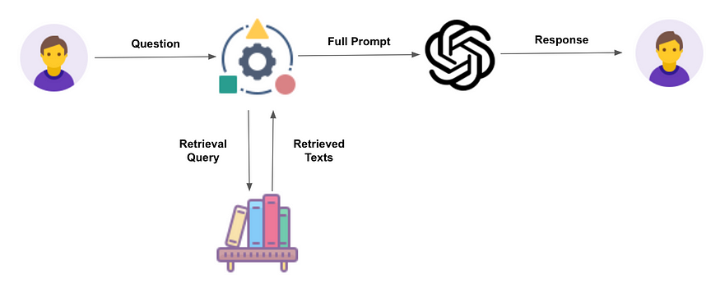
Terminologies: RAG
Retrieval augmented generation (RAG)
LLM reads large amount of text and find the information user need.
(So far, RAG is one of the most successful real-world application, including smart agent, file management, etc.)

Slide 21
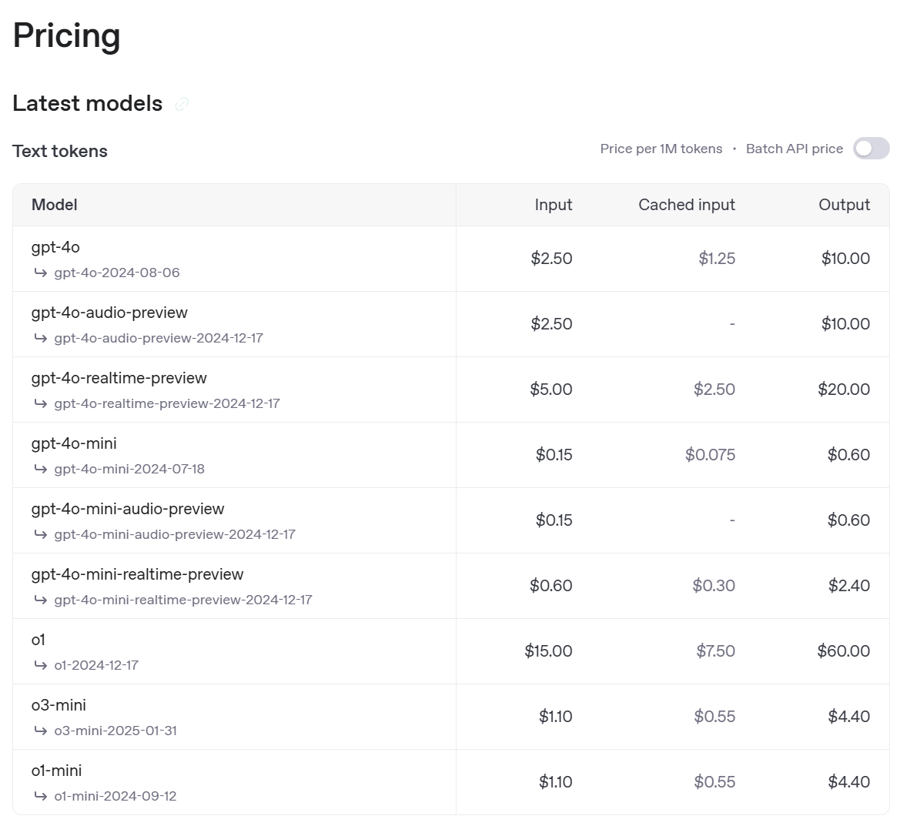
Run LLM online
ChatGPT and OpenAI API https://platform.openai.com/docs/models

Slide 22
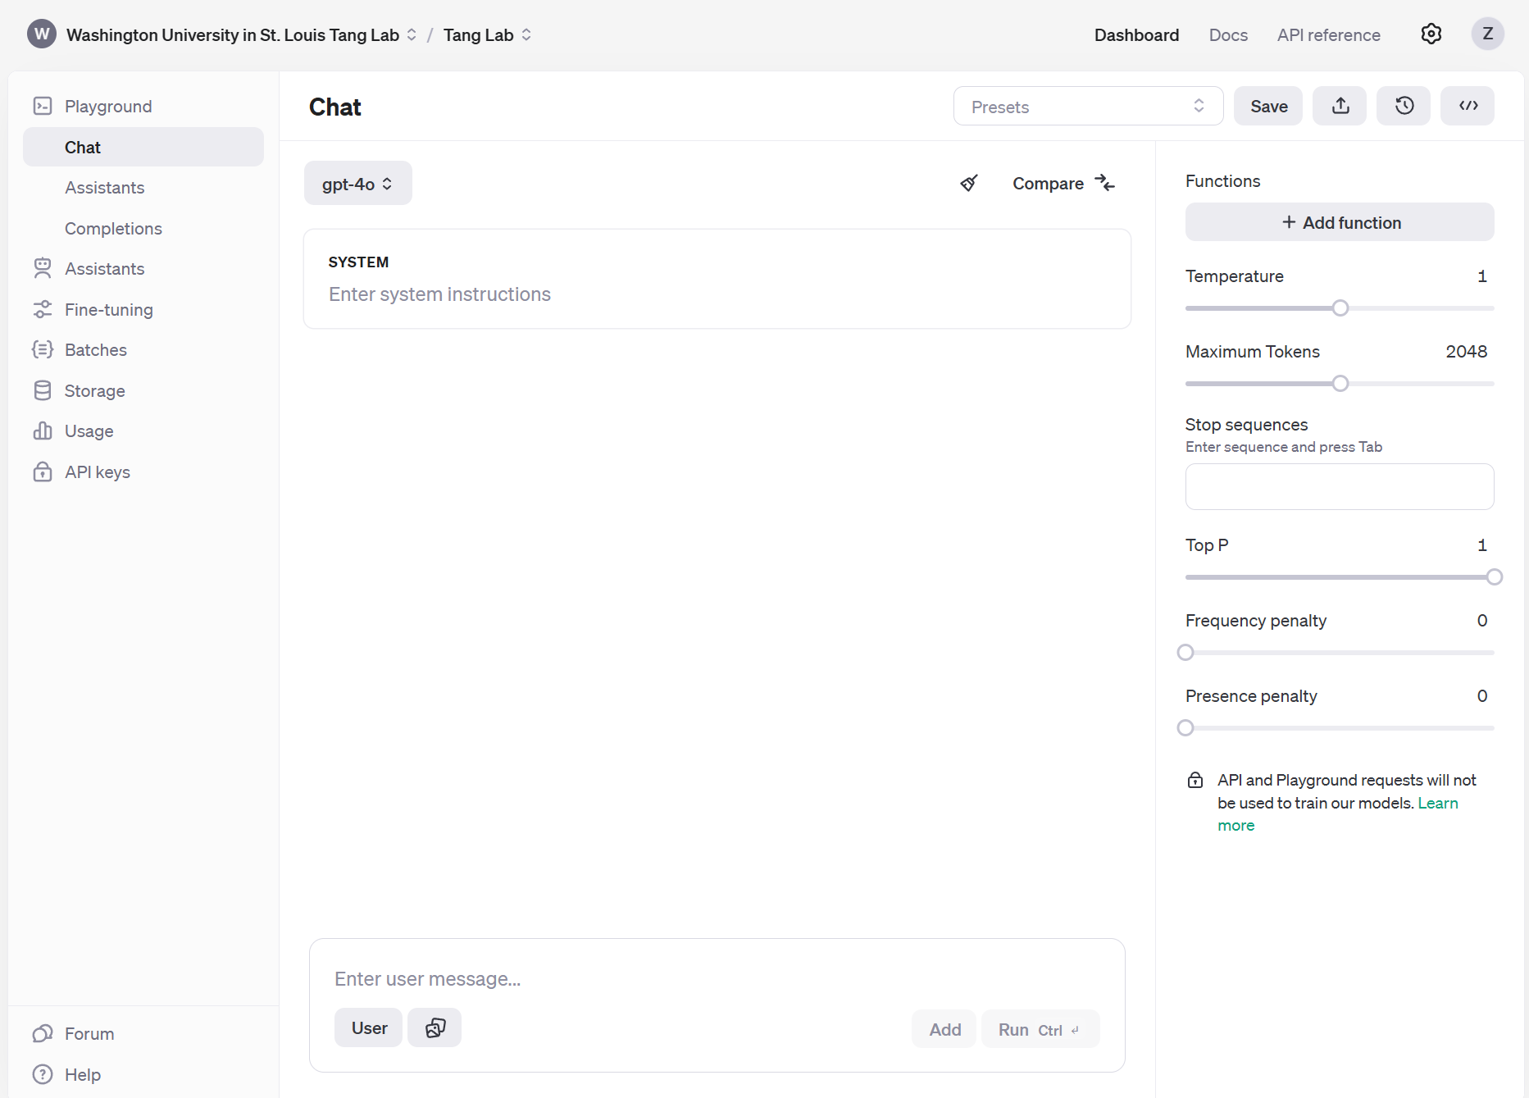
Run LLM online (demo)
OpenAI API playground https://platform.openai.com/playground/chat?models=gpt-4o
Send me your emails and I will invite you to the group.

Slide 23
Run LLM locally (servers)
Running LLM on servers are inevitable, because GPUs are expensive. Rent servers are usually more economic than purchasing GPU.
Prerequisite
Linux command
Setup Python environment *** CUDA version, install packages (torch, transformers, flash attention …)
Troubleshooting *** Search engines can help.
GPU server providers
University infrastructure RIS
Commercial services: Google Colab, Lambda, Azure, AWS…
However, running on servers is still not 100% secure.

Slide 24
Run LLM locally
Reasons for running LLM locally
Privacy and data security ***IMPORTANT***
Bypass API request rate limit
Reproducibility
Cost effective
Options: CPU and GPU
Run LLM locally requires quantization
The LLM speed depends on your hardware.
 | Intel or AMD x86 CPU | Nvidia GPU | Apple’s M series SoC
Memory | Low bandwidth DDR4 or DDR5 | High bandwidth GDDR6X or GDDR7 | High bandwidth unified memory
Computation | CPU cores | CUDA/Tensor cores | GPU cores
Quantization method | GGUF | GGUF, GPTQ | GGUF, MLX
Advantage | Low cost | High speed inference | Large unified memory

Slide 25
Download LLM models
Hardware survey
How many GB of RAM is on your computer?
Windows or Mac? Do you have GPU?
Your hardware determines the size of LLM you can run. LLMs are not equal in performance.
Note: you need extra memory for longer context length.
Purpose | Model size | Memory usage (Int4 quantization) | Recommended memory
For fun | 3B | 1.9 GB | 8 GB
 | 7B | 4.7 GB
Asist daily work | 14B | 9.0 GB | 12 GB, GPU recommended (RTX4070)
 | 32B | 20 GB | 24 GB, GPU recommended (RTX4090)
Enterprise-level application | 70B | 43 GB | 2*24 GB, GPU required (2*RTX4090)
 | 671B (MoE) | 404 GB | Data center GPU only (6*H100) Or Mac unified memory

Slide 26
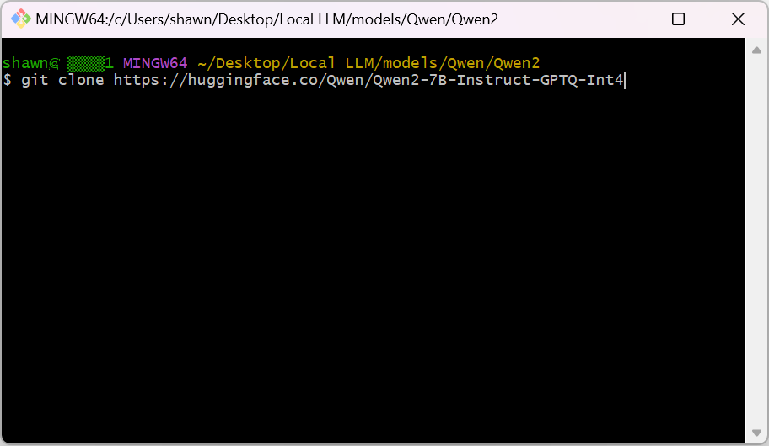
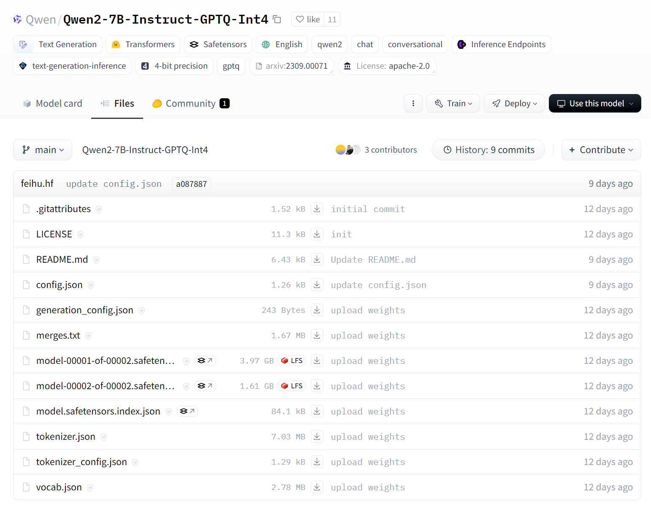
Run LLM locally
Download pretrained LLM from Hugging Face
Hugging Face uses Git LFS
Download Git LFS
Open Git bash and type in the following command as an example
Or download from Hugging Face webpage one by one

Slide 27
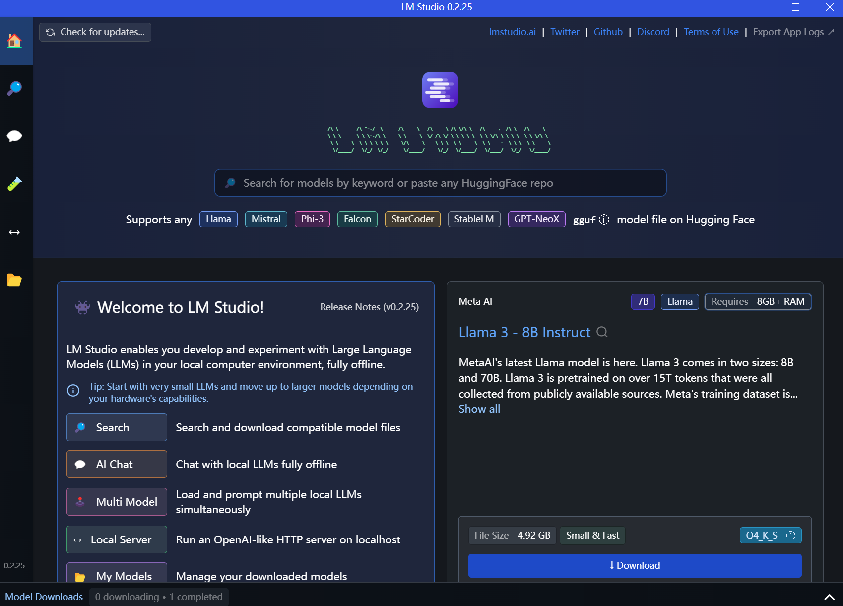
Run LLM locally (demo)
Use a python script
Install python and necessary libraries
Load the model
Input system prompt and user prompt
Get LLM output
Tune model parameter if necessary
Temperature, repeat penalty, etc.
Use LM studio
User friendly graphical interface
Load the model
Load preset
Get LLM output
Tune model parameter if necessary
Temperature, repeat penalty, etc.

Slide 28
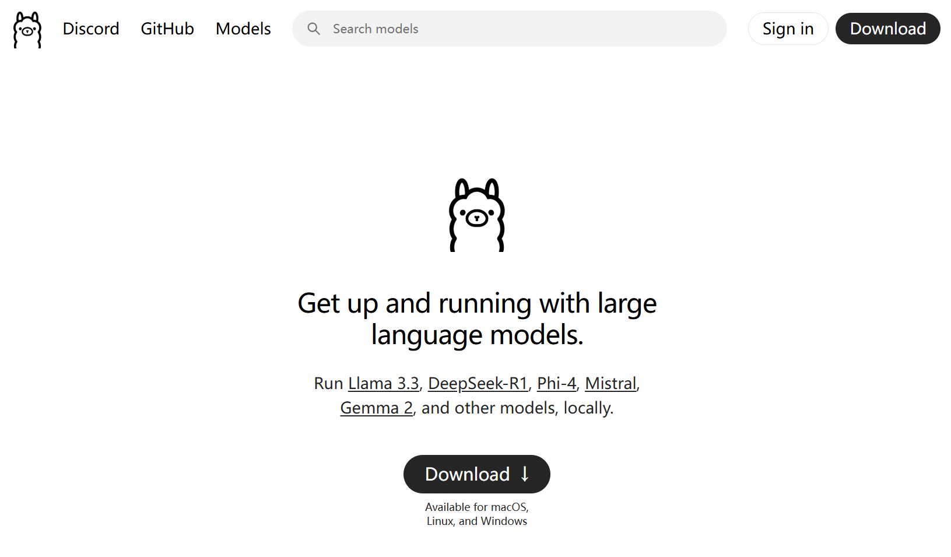
Run LLM locally (demo)
Use ollama https://ollama.com/ ollama opens a local LLM API for other apps, such as GraphRAG
We will demonstrate GraphRAG in this course.

Slide 29
Evaluate LLM on homework/exam questions
Given some EECE506 Bioprocess Engineering homework/exam questions, how does LLM perform?
Keep in mind:
LLMs are stochastic. Each response is different.
It’s difficult to explain LLM’s logic due to its self-supervised training.

Slide 30
Try paper review on your local LLM
Use the paper distributed last Monday.

Slide 31
GraphRAG
GraphRAG converts text into knowledge graph.
Official website and documentations https://microsoft.github.io/graphrag/
A mini-project for this class (optional) https://github.com/xiao-zhengyang/EECE506-SP2025

Slide 32
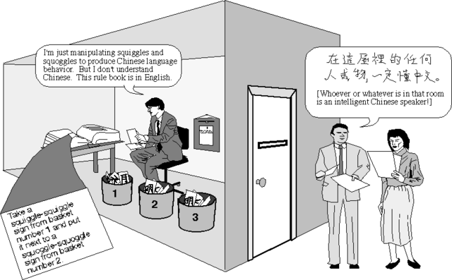
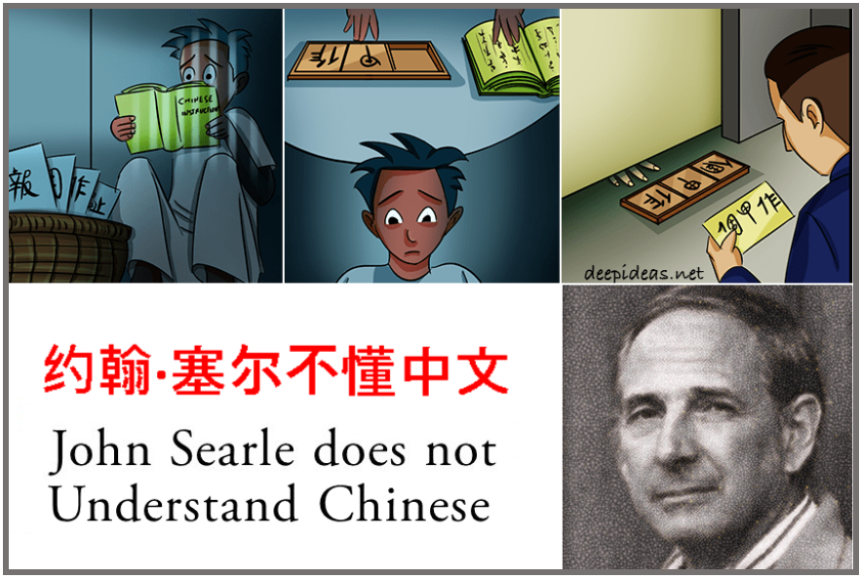
AI ethics
Can LLM think? Can it have rights?
John Searle’s Chinese room argument

Slide 33
AI ethics
AI in daily works
Academic integrity
Dual-use technology
Do no harm
Ensure safety Establish accountability
Ensure fairness Uphold human rights and values
Respect privacy Reflect diversity/inclusion
Promote collaboration Avoid concentration of power
Provide transparency Acknowledge legal/policy implications
Limit harmful uses of AI Contemplate implications for employment

